Slide 1
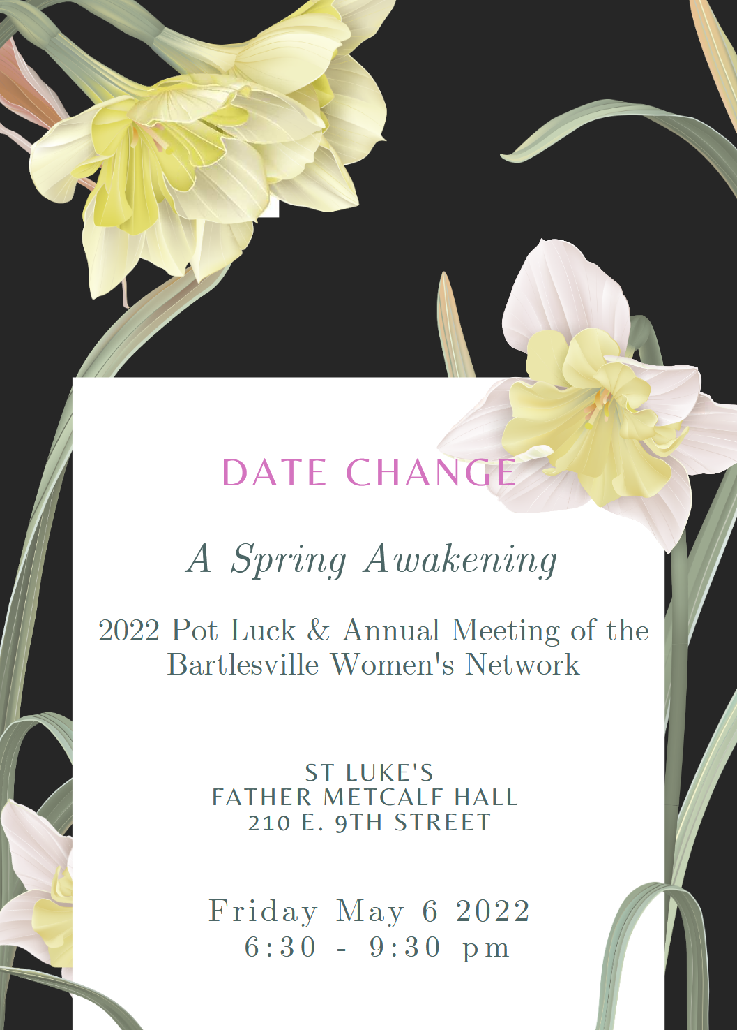
BARTLESVILLE WOMEN'S NETWORK
March 2022
WOMEN'S NETWORK
Please note the new date: Friday May 6
Page 1 of 4
Page 2 of 4

Slide 2

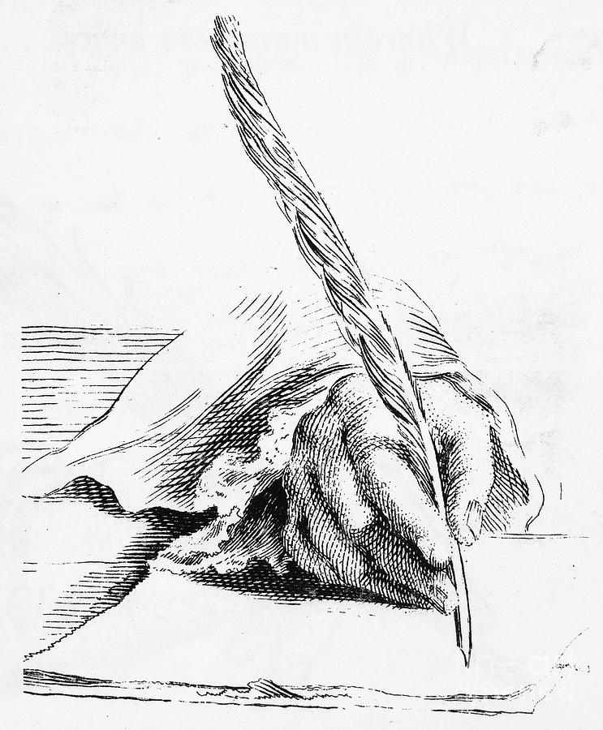
BARTLESVILLE WOMEN'S NETWORK
March 2022
ANNUAL MEETING POT-LUCK DINNER coming in May!
The Bartlesville Women’s Network 2022 Annual Meeting will be held Friday, May 6th, 6:30-9:30 pm at Father Metcalf Hall, St. Luke’s Episcopal Church, 210 E. 9th Street. (Entry and parking on the north side of the building).
This year’s meeting will be a Pot-Luck dinner with the theme of a SPRING AWAKENING! (Thanks to Vanessa Drummond for the lovely flier!) With that theme in mind, please be thinking about what you might be able to prepare for the Pot-Luck dinner that reflects the possibilities of springtime! A spring chicken or lamb dish? Green salads? Early spring vegetable dish? Or a mint or berry dessert? These are just some ideas to get your chef imaginations working! (Beverages and wine will be provided by BWN.)
Those whose last names end in A-M should bring light meat or vegetable dishes or salads, those whose last names end in N-Z should bring desserts. No need to call in your planned offering, unless you have a question to ask, in which case, please call Sidney Brammer at (xxx)xxx-xxx (masked for privacy), between 5 and 7 pm only.
After a couple of spring snowstorms, prolonged chilly weather, and on-again/off-again pandemic lockdowns, we sense a strong need in everyone to come together again in fellowship and celebration of our past accomplishments, as well as those forthcoming! Some BWN membership business will be attended to, also. And please
feel free to bring an interested friend to introduce to the Bartlesville Women’s Network!
We hope to see everyone on May 6th at St. Luke’s!
By Program Chairs
Sidney Brammer and Vanessa Drummond
Letter from the President
As we close another year on the
Bartlesville Woman's Network, I
would like to thank the
membership and board for allowing me the opportunity to serve as your President. I'm sorry to say we didn't have the opportunity to do all we wanted, but we did get together for a few socials. We were able to come together and enjoy the gatherings for happy hour and our traditional holiday dinner.
Hopefully the upcoming 2022 - 2023 year will bring the Woman's Network back into the Bartlesville spotlight with hosting monthly meetings and speakers.
Regards,
Karen Wollman
2021 - 2022 President
Bartlesville Woman's Network
Page 2 of 4
Page 2 of 4

Slide 3


BARTLESVILLE WOMEN'S NETWORK
March 2022
Library Dedication for Diane Dixon
﻿WHEN: Friday, April 8, 3:00 pm
WHERE: North Parking Lot of Bartlesville Library
Please come by and say hi to old friends, have a cookie, remember our old friends gone. If you have any fun pictures of Diane or Judy too, please bring them to share on the table. You can take back when you leave. Any questions please call or email Eva Boatwright (contact info removed for privacy protection). This was made possible through the generosity of the members of the Bookies Book Club whose president was Diane.
Contributed by Eva Boatwright
Time and Location: Penny Eccleston’s house on Sunday April 24th at 2pm. This is the Sunday after Easter.
Book: Come Fly the World: The Jet-Age Story of the Women of Pan Am by Julia Cooke
Glamour, danger, liberation: in a Mad Men–era of commercial flight, Pan Am World Airways attracted the kind of young woman who wanted out, and wanted up
Required to have a college education, speak two languages, and possess the political savvy of a Foreign Service officer, a jet-age stewardess serving on iconic Pan Am between 1966 and 1975 also had to be between 5′3" and 5′9", between 105 and 140 pounds, and under 26 years of age at the time of hire. Cooke’s intimate storytelling weaves together the real-life stories of a memorable cast of characters, from small-town girl Lynne Totten, a science major who decided life in a lab was not for her, to Hazel Bowie, one of the relatively few Black stewardesses of the era, as they embraced the liberation of their new jet-set life. Cooke brings to light the story of Pan Am stewardesses’ role in the Vietnam War, as the airline added runs from Saigon to Hong Kong for planeloads of weary young soldiers straight from the battlefields, who were off for five days of R&R, and then flown back to war. Finally, with Operation Babylift—the dramatic evacuation of 2,000 children during the fall of Saigon—the book’s special cast of stewardesses unites to play an extraordinary role on the world stage.
By Franny Hildabrand
Past event: A mass was said for Fred and Judy Pecher on Saturday March 26th at St James at 08:30 AM
Check out our new website: https://bartlesvillewomensnetwork.org/
Construction of this website is not complete yet. If you have any suggestions, or would like to help, contact Lili Gao at bvillewomensnetwork@gmail.com.
Page 3 of 4

Slide 4


BARTLESVILLE WOMEN'S NETWORK
March 2022
Women's History Month Events
BAHM (Bartlesville Area History Museum) has two special events planned on March 15 and March 17, in honor of Women’s History Month.
BAHM will host a tea party beginning at 1:30 p.m. on March 15 at the museum, located on the fifth floor of City Hall, 401 S. Johnstone Ave.
“We planned this event specifically during Spring Break to allow ladies of all ages to come,” said Education Coordinator Betty Keim. “We will be enjoying some yummy snacks and tea while we really dig into the history-making ladies of the Bartlesville area. Mark your calendars for this event.”
Guests are encouraged to dress in Victorian attire if they would like, but there is no dress code for the event. RSVP by March 12: 918.338.4290 or history@cityofbartlesville.org.
On March 17, the museum will be open from 6-8 p.m. for its Third Thursday hours. At 6:30 p.m. Keim will give a presentation on the history of women who shaped Bartlesville and the surrounding communities. Light refreshments will be served.
BAHM is open Monday through Friday from 8:30 a.m. to 4 p.m. Museum entry is free, but donations are accepted.
(From City newsletter)
Contributed by Deborah Langley
Glenda Collins has returned to write more news features about the arts in Oklahoma and the region, after some setbacks of broken wrist, pandemic, and relocation. These news features along with some upcoming art events can be found on her website: https://glendaricecollins.com/ (best viewed on computer), where people can comment and share the articles. Glenda has been attending events impacting local artists. She visited Arts & Culture Day at the Oklahoma State Capitol on March 23, and interacted with our state governor and other decision makers. She visited the world premiere of the Native American musical Distant Thunder, coordinated by Lyric Theater of Oklahoma on March 24, 2022. Glenda shared some resources of local art: Oklahoma Arts Council's diverse programs and events, Oklahomans for the Arts, and Oklahoma Contemporary Arts Center, which just opened prior to the 2020 pandemic lockdowns.
“Feb 28 Fran Stallings was delighted to do her first in-person performance in ages, for almost 400 K-2nd graders at Bristow’s Edison Elementary School. Through these pandemic years these kids had had NO previous experience attending assemblies, but Fran's stories kept them focused and teachers were delighted. She has been performing over Zoom nationwide, overseas, for Washington Co Master Gardeners, and even at Bartlesville’s Ranch Heights Elementary School. Meanwhile, Fran is co-chairing a virtual international conference April 8-10 https://storynet.org/Earth-Up/."
Page 4 of 4

